Slide 1

6th Grade Math
Unit 11, Lesson 6 What Values Make an Equation or Inequality True? Volume 2, pg. 266

Slide 2


Benchmark
MA.6.AR.2.1
Given an equation or inequality and a specified set of integer values, determine which values make the equation or inequality true or false.
volume 2, pg. 266

Slide 3
Integrated Mathematical Thinking and Reasoning Standards
MA.K12.MTR.1.1 Actively participate in effortful learning both individually and collectively.
MA.K12.MTR.4.1 Engage in discussions that reflect on the mathematical thinking of self and others.
MA.K12.MTR.5.1 Use patterns and structure to help understand and connect mathematical concepts.
MA.K12.MTR.6.1 Assess the reasonableness of solutions.
volume 2, pg. 266

Slide 4

Learning Target
I can determine if a given integer value makes an equation or inequality true.
volume 2, pg. 266

Slide 5

Warm-Up
volume 2, pg. 266

Slide 6
11.6.1 Warm-Up: Day at Work – Film Composer
Shohan Cagle is a film composer. He writes music for commercials and soundtracks for TV shows and movies.
What did you notice about what he does to write a soundtrack?
Shohan said that most people say they don’t normally hear the soundtrack. Name a TV show or a movie whose soundtrack you remember.
Shohan mentioned that one of his challenges is a short deadline. He said that his strategy to get his work done is “to sit and focus and get in the right mindset”. How can you use Shohan’s strategy?
volume 2, pg. 266

Slide 7

Guided Instruction
volume 2, pg. 267

Slide 8

11.6.2 Guided Instruction: Determining Values That Make an Equation True or False
An equation is a mathematical relation statement where two equivalent expressions and values are separated by an equal sign.
In the equation $4x+5=8x−23$, what are the two expressions?
volume 2, pg. 267

Slide 9
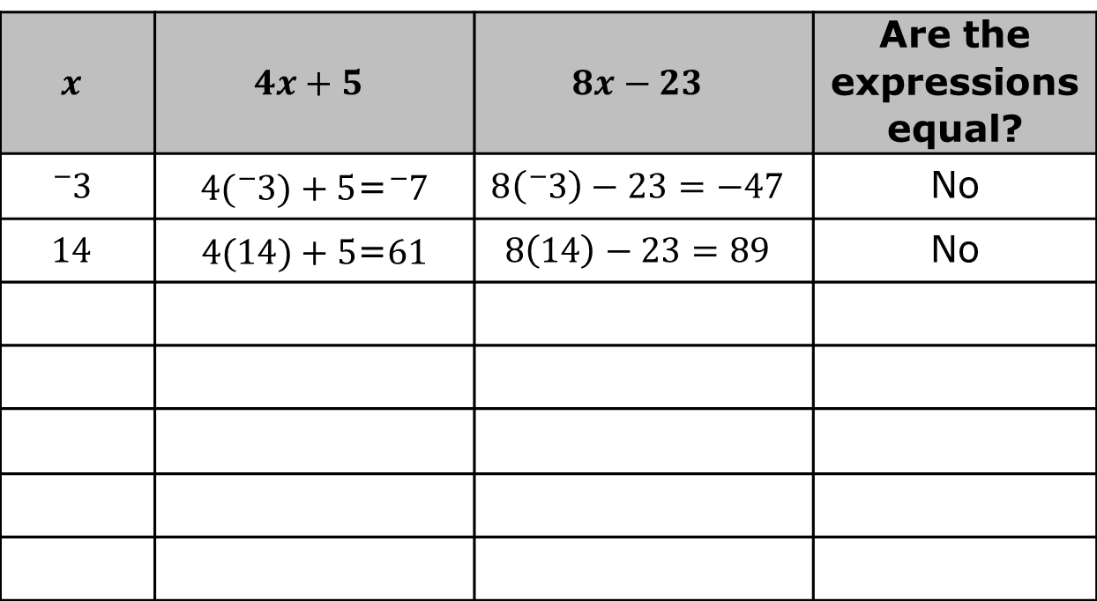
Work with your partner to guess a value for $x$ and then substitute it into both expressions. A high and a low guess have been provided for you in the table.
$$x$$ | $$4x+5$$ | $$8x−23$$ | Are the expressions equal?
$${}_{}^{−}3$$ | $4({}_{}^{−}3)+5$=${}_{}^{−}7$ | $$8\left({}_{}^{−}3\right)−23=−47$$ | No
$$14$$ | $4(14)+5$=$61$ | $$8\left(14\right)−23=89$$ | No
volume 2, pg. 267

Slide 10
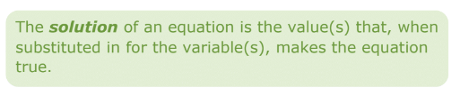
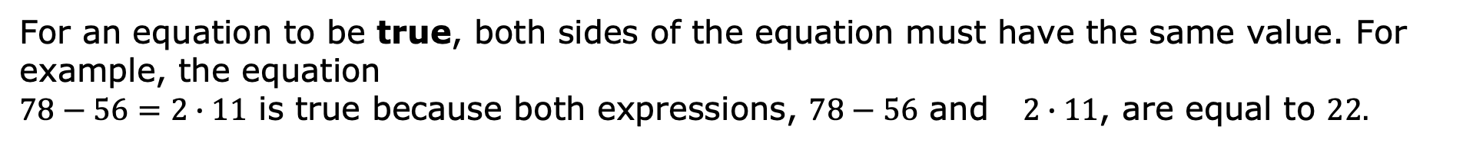
For an equation to be true, both sides of the equation must have the same value. For example, the equation
$78−56=2∙11$ is true because both expressions, $78−56$ and $2∙11$, are equal to $22.$
Based on your guesses, what is the solution to the equation $4x+5=8x−23$?
volume 2, pg. 267

Slide 11
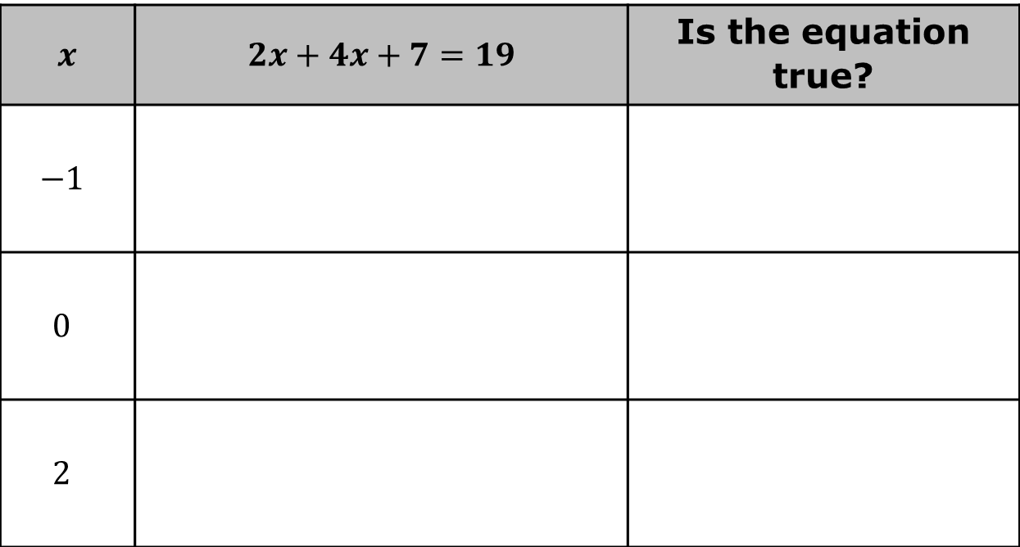

Use substitution to determine if the equation $2x+4x+7=19$ is true for each value.
The solution to the equation $2x+4x+7=19$ is $x=$ ____ because when this value is substituted for $x$, the equation is ________.
$x$ | $2x+4x+7=19$ | Is the equation true?
$$−1$$
$$0$$
$$2$$
volume 2, pg. 268

Slide 12

Guided Practice
volume 2, pg. 268

Slide 13

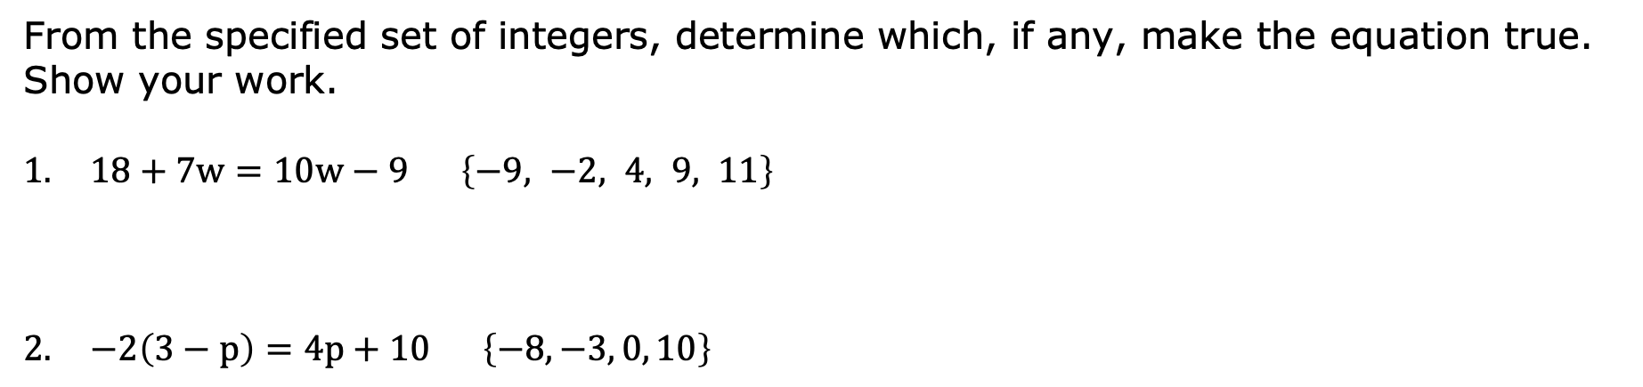
11.6.3 Guided Practice: Determining Which Values Make an Equation True or False
From the specified set of integers, determine which, if any, make the equation true. Show your work.
$18+7w=10w−9$ $\left\{−9, −2, 4, 9, 11\right\}$
$−2\left(3−p\right)=4p+10$ $\left\{−8, −3, 0, 10\right\}$
volume 2, pg. 268

Slide 14
Guided Instruction
volume 2, pg. 269

Slide 15
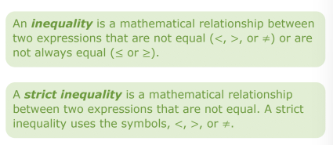
11.6.4 Guided Instruction: Determining Values That Make an Inequality True or False
volume 2, pg. 269

Slide 16
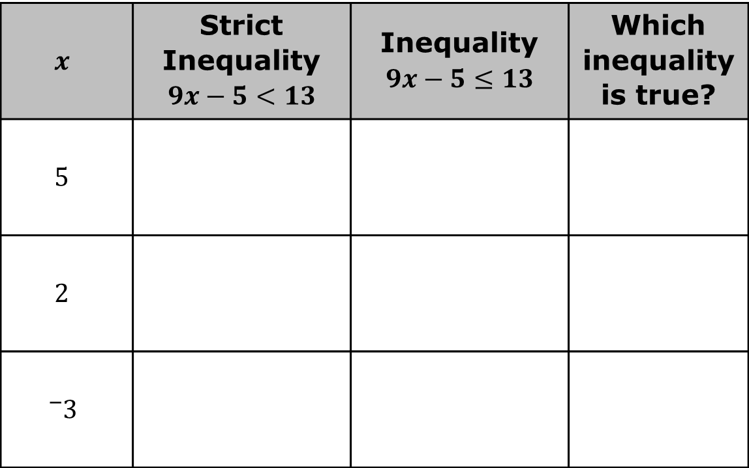
Use substitution to evaluate the mathematical statement. Then determine if each inequality is true for the value of $x$.
$$x$$ | Strict Inequality $$9x−5<13$$ | Inequality $$9x−5≤13$$ | Which inequality is true?
$$5$$
$$2$$
$${}_{}^{−}3$$
volume 2, pg. 269

Slide 17
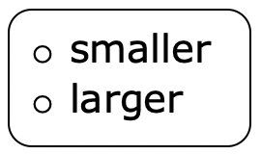
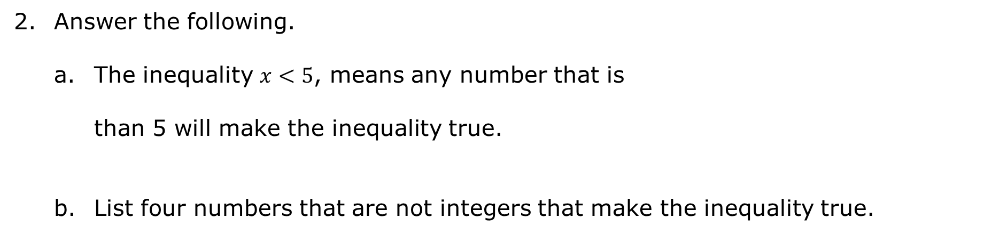
Answer the following.
The inequality $x<5$, means any number that is than 5 will make the inequality true.
List four numbers that are not integers that make the inequality true.
volume 2, pg. 269

Slide 18
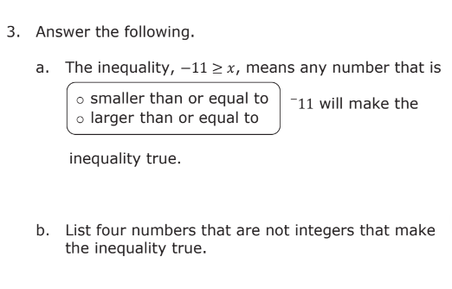
volume 2, pg. 269

Slide 19
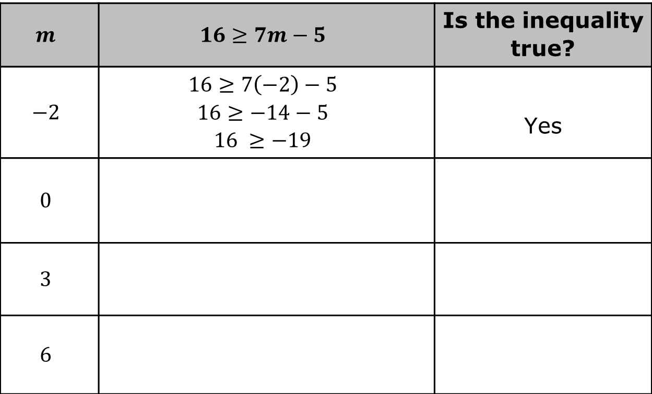
Use substitution to determine if the inequality $16≥7m−5$ is true for each value specified for $m$.
$$m$$ | $$16≥7m−5$$ | Is the inequality true?
$$−2$$ | $$16≥7\left(−2\right)−5$$ $$16≥−14−5$$ $$16 ≥−19$$ | Yes
$$0$$
$$3$$
$$6$$
volume 2, pg. 270

Slide 20
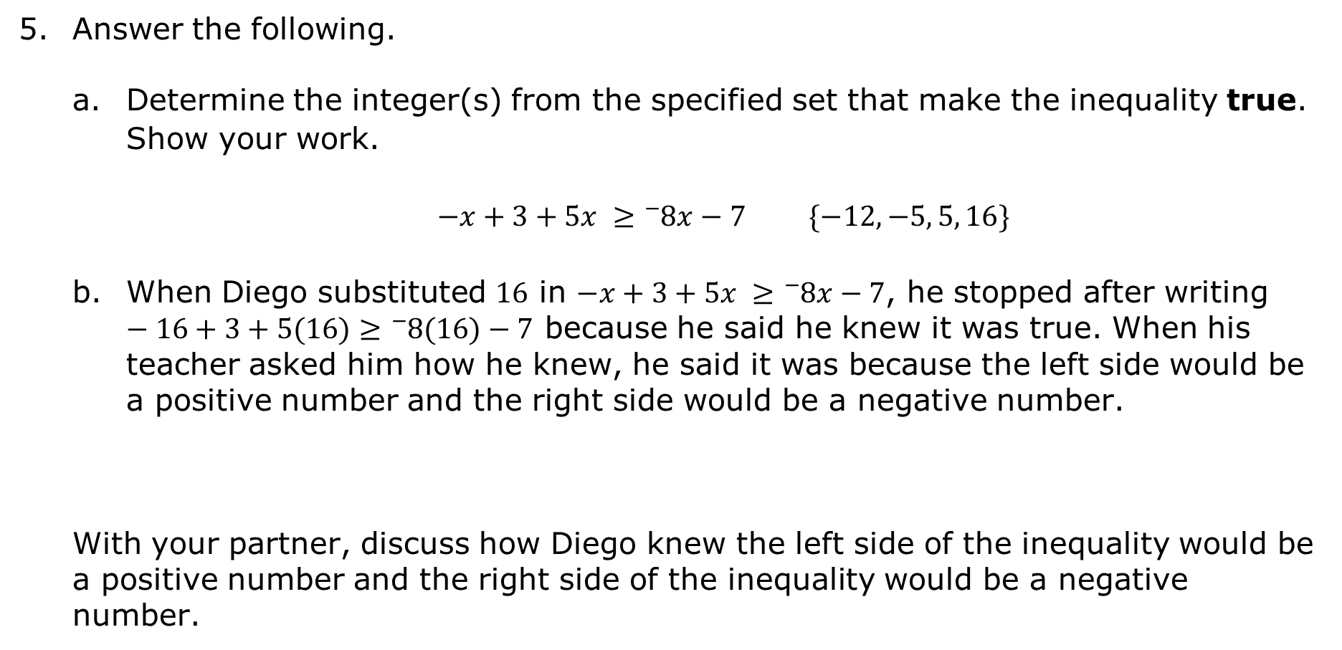
Answer the following.
Determine the integer(s) from the specified set that make the inequality true. Show your work.
$−x+3+5x ≥{}_{}^{−}8x−7$ $\{−12, −5, 5, 16\}$
When Diego substituted $16$ in $−x+3+5x ≥{}_{}^{−}8x−7$, he stopped after writing $−16+3+5(16)≥{}_{}^{−}8(16)−7$ because he said he knew it was true. When his teacher asked him how he knew, he said it was because the left side would be a positive number and the right side would be a negative number.
With your partner, discuss how Diego knew the left side of the inequality would be a positive number and the right side of the inequality would be a negative number.
volume 2, pg. 270

Slide 21
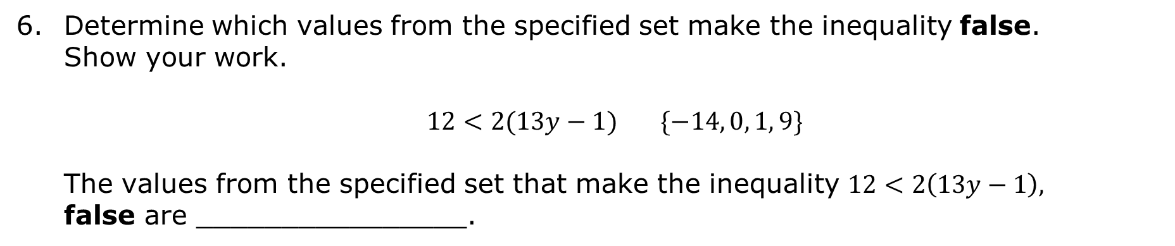
Determine which values from the specified set make the inequality false. Show your work.
$12<2(13y−1)$ $\{−14, 0, 1, 9\}$
The values from the specified set that make the inequality $12<2\left(13y−1\right),$ false are ________________.
volume 2, pg. 271

Slide 22

Your Turn
volume 2, pg. 271

Slide 23
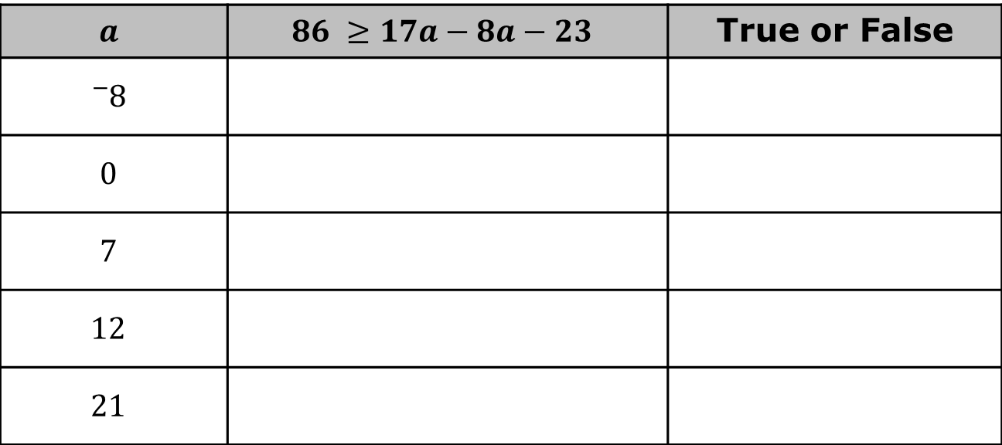
11.6.5 Your Turn!
Use substitution to determine if the inequality $86 ≥17a−8a−23$ is true or false for each integer value specified for $a$.
$$a$$ | $$86 ≥17a−8a−23$$ | True or False
$${}_{}^{−}8$$
$$0$$
$$7$$
$$12$$
$$21$$
volume 2, pg. 271

Slide 24

Wrap-Up
volume 2, pg. 272

Slide 25
11.6.6 Wrap-Up: Reflection
One question I still have after today’s lesson is …
_______________________________________________
_______________________________________________
______________________________________________?
Today I am still unsure about …
_______________________________________________
_______________________________________________
______________________________________________.
volume 2, pg. 272

Slide 26
To fill in this gap I intend to …
_______________________________________________
_______________________________________________
______________________________________________.
volume 2, pg. 272

